Slide 1


myDNS
Project Factory
Nuno Cardoso Nº 50033210

Slide 2
Project Factory
myDNS
Scenarios & Personas;
Functional Requirements & Non-Functional Requirements;
Domain Model;
Mockups & Interfaces;
Project Charter & WBS.

Slide 3
myDNS
Scenarios & Personnas
Scenarios:
A) The user selects from a list of domain names, designate the IP address for that selected domain name save and make the appropriate changes.
B) The client can change any of his own information like: password, company name, first name, last name, city, postal-code, phone, fax, email, country, credit card type, credit card number, expiration date – year and expiration date -month
C)The administrator must be able to change/remove values from the DNS table and change/remove registered users.
Personnas:
Client;
Admin.
3

Slide 4
myDNS
Functional Requirements & Non-Functional Requiremts
Functional Requirements:
Non-Functional Requirements:
# | Requirement | Description | Priority
FR:01 | Link to HomePage | Title must redirect the user to the main home page | HIGH
FR02 | Link to Client Page/Domains Page | Navigation bar must redirect to every single page on the website | HIGH
FR03 | Link to Admin Page | Navigation bar must redirect to every single page on the website | HIGH
FR04 | Display Domain Names | Display a list of all domain names available | HIGH
FR05 | Insert IP Addresses to Allocate | Insert an IP with a Domain Name selected | HIGH
FR06 | Change Settings | Change client settings/personal information | HIGH
FR07 | Clients RU | Administrators must be able to remove or change clients | HIGH
# | Requirement | Description | Priority
NFR01 | W3C | All data shall be seen in 3 clicks | LOW
NFR02 | Interoperability | Runable on various devices | LOW
NFR03 | Scalability | Up to 254 clients | LOW
4

Slide 5
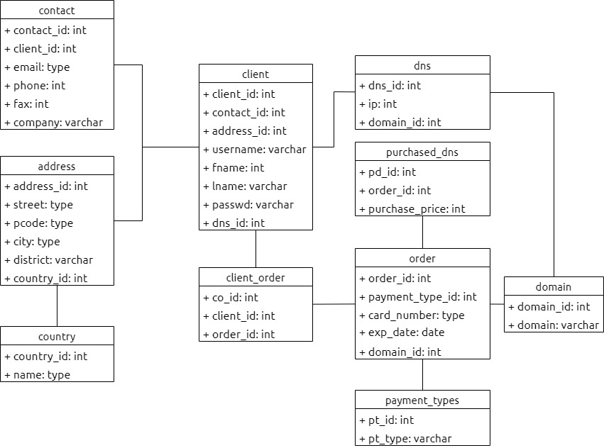
myDNS
Domain Model
5

Slide 6
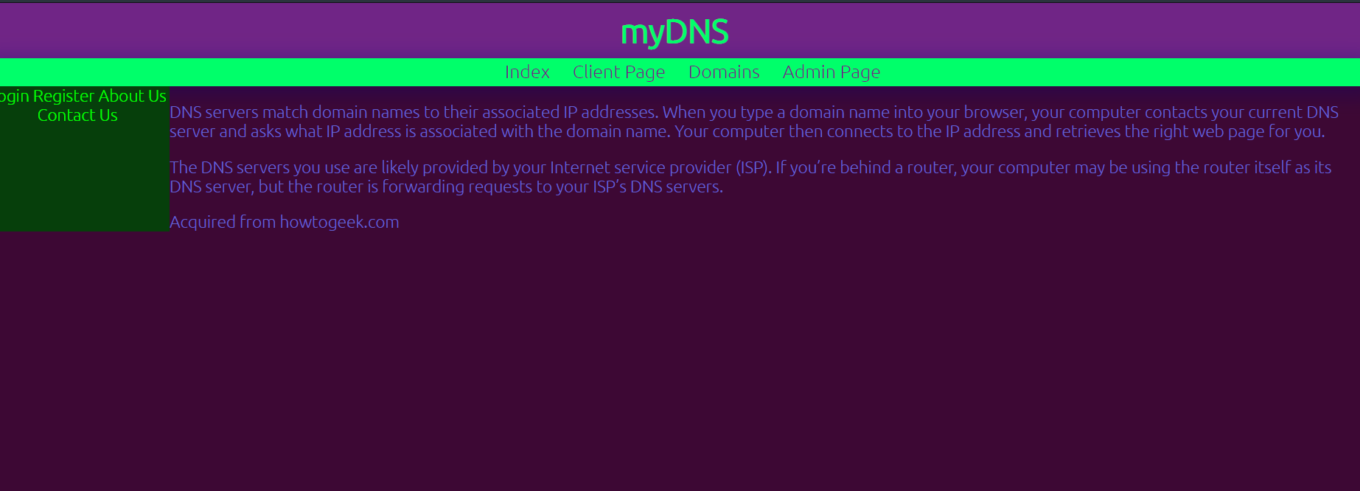
myDNS
Mockups & Interfaces
Main Page
6

Slide 7
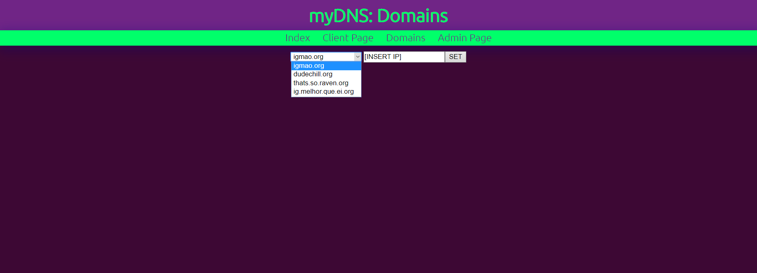
myDNS
Mockups & Interfaces
Domains Page
7

Slide 8
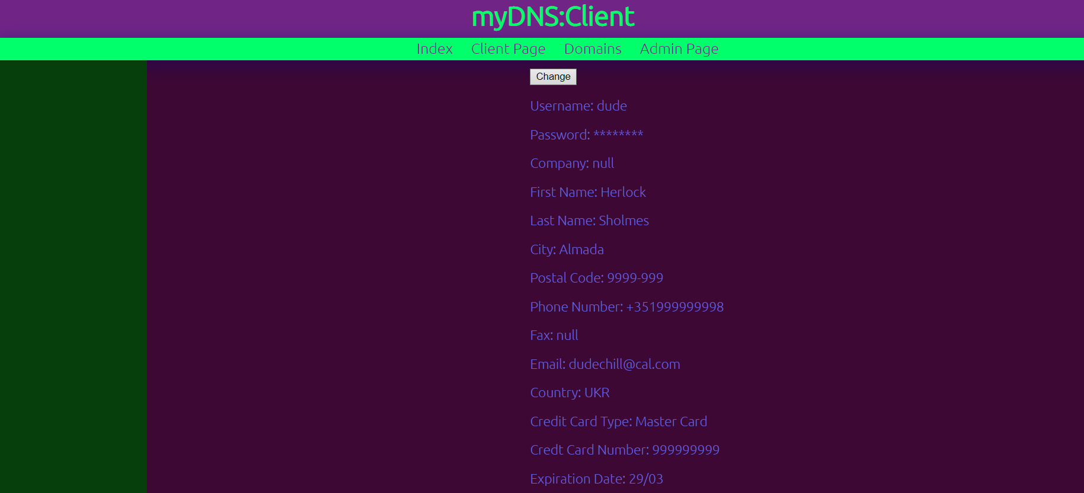
myDNS
Mockups & Interfaces
Client Page
8

Slide 9
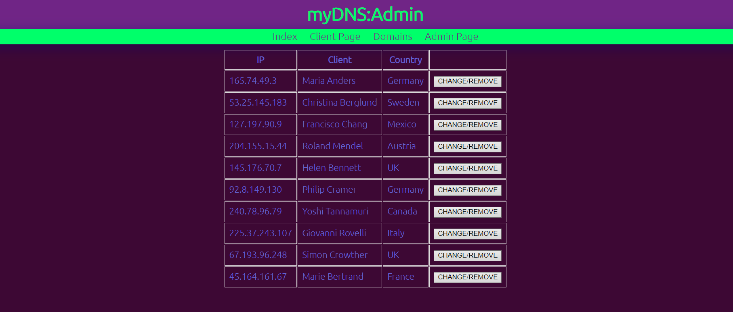
myDNS
Mockups & Interfaces
Administrador Page
9

Slide 10
myDNS
Project Charter and WBS
10

